Slide 1
Support Vector Machine
Group D
MCE 079 05534 Rokibul Hasan
MCE 079 05535 Sumon Kumar Ghosh
MCE 079 05536 Shyed Shahriar Housaini
MCE 079 05537 Anjan Chandra Das
MCE 079 05538 Abdul Bari

Slide 2
Content Layout
Support Vector Machine Algorithm
Support Vector Machine Background
Support Vector Machines explanation
Types of Support Vector Machine
Support Vector Machine | Linear SVM Example
Support Vector Machine | Non-Linear SVM Example

Slide 3
Support Vector Machine Algorithm
Support Vector Machine or SVM is one of the most popular Supervised Learning algorithms, which is used for Classification as well as Regression problems. However, primarily, it is used for Classification problems in Machine Learning.
The goal of the SVM algorithm is to create the best line or decision boundary that can segregate n-dimensional space into classes so that we can easily put the new data point in the correct category in the future. This best decision boundary is called a hyperplane.

Slide 4

SVM chooses the extreme points/vectors that help in creating the hyperplane. These extreme cases are called as support vectors, and hence algorithm is termed as Support Vector Machine. Consider the below diagram in which there are two different categories that are classified using a decision boundary or hyperplane:

Slide 5
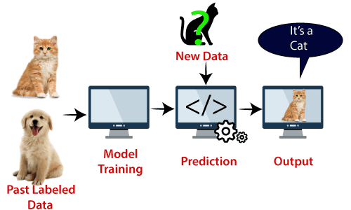
Example: SVM can be understood with the example that we have used in the KNN classifier. Suppose we see a strange cat that also has some features of dogs, so if we want a model that can accurately identify whether it is a cat or dog, so such a model can be created by using the SVM algorithm. We will first train our model with lots of images of cats and dogs so that it can learn about different features of cats and dogs, and then we test it with this strange creature. So as support vector creates a decision boundary between these two data (cat and dog) and choose extreme cases (support vectors), it will see the extreme case of cat and dog. On the basis of the support vectors, it will classify it as a cat. Consider the below diagram:
SVM algorithm can be used for Face detection, image classification, text categorization, etc.

Slide 6
Support Vector Machine Background
Support Vector Machine (SVM) is a supervised classification method derived from statistical learning theory that often yields good classification results from complex and noisy data. It separates the classes with a decision surface that maximizes the margin between the classes. The surface is often called the optimal hyperplane, and the data points closest to the hyperplane are called support vectors. The support vectors are the critical elements of the training set.

Slide 7
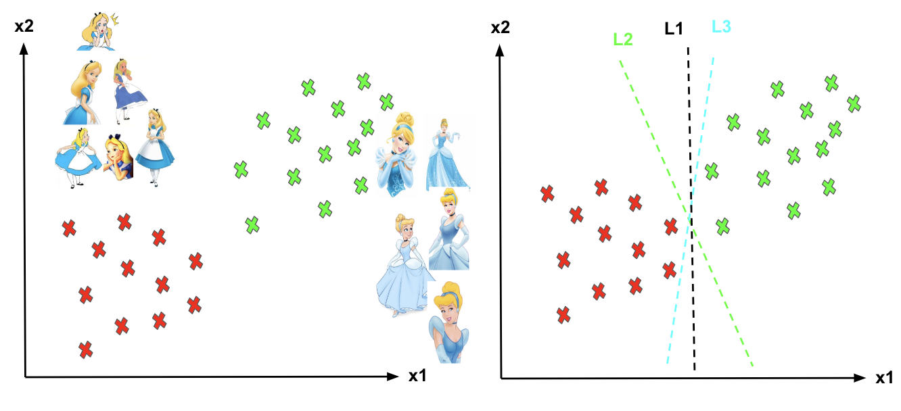
Support Vector Machines explanation
Imagine the labelled training set are two classes of data points (two dimensions): Alice and Cinderella. To separate the two classes, there are so many possible options of hyperplanes that separate correctly. As shown in the graph below, we can achieve exactly the same result using different hyperplanes (L1, L2, L3). However, if we add new data points, the consequence of using various hyperplanes will be very different in terms of classifying new data point into the right group of class.
Different hyperplanes (L1, L2, L3).

Slide 8
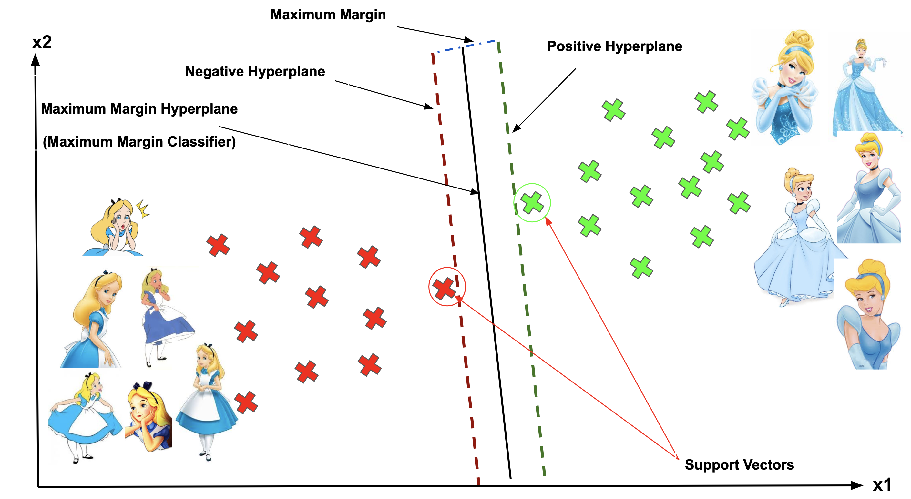
How can we decide a separating line for the classes? Which hyperplane shall we use?

Slide 9
Support Vector, Hyperplane, and Margin
The vector points closest to the hyperplane are known as the support vector points because only these two points are contributing to the result of the algorithm, and other points are not. If a data point is not a support vector, removing it has no effect on the model. On the other hand, deleting the support vectors will then change the position of the hyperplane.
The dimension of the hyperplane depends upon the number of features. If the number of input features is 2, then the hyperplane is just a line. If the number of input features is 3, then the hyperplane becomes a two-dimensional plane. It becomes difficult to imagine when the number of features exceeds 3.
The distance of the vectors from the hyperplane is called the margin, which is a separation of a line to the closest class points. We would like to choose a hyperplane that maximises the margin between classes. The graph below shows what good margin and bad margin are.

Slide 10
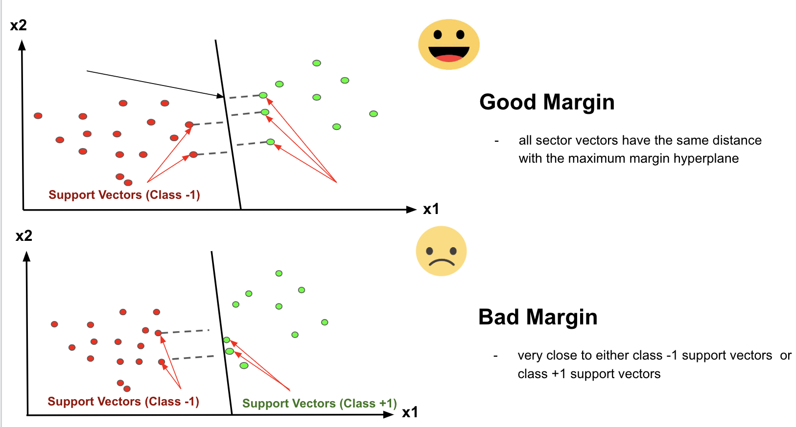
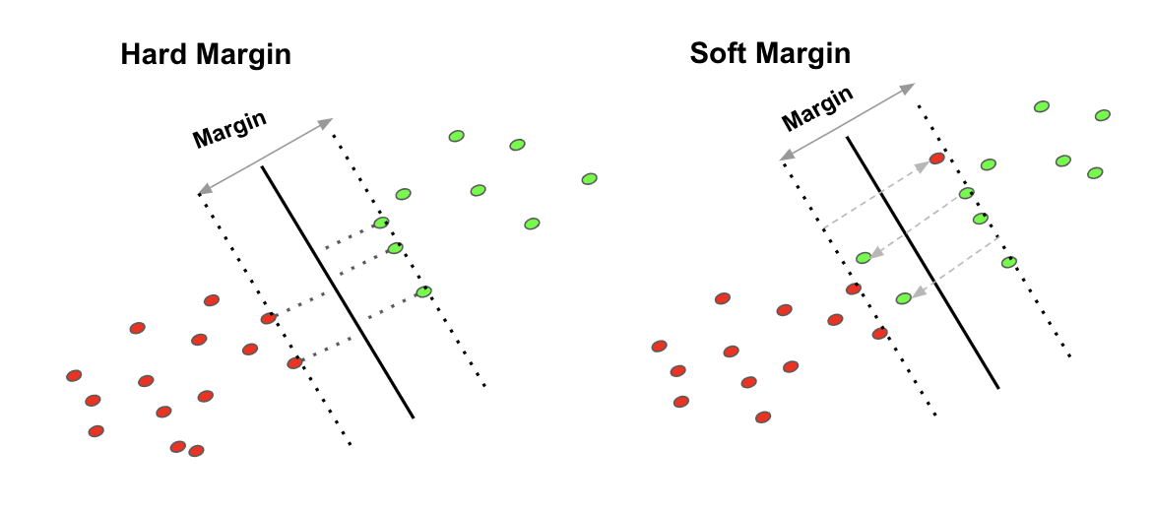

Slide 11
Hard Margin
If the training data is linearly separable, we can select two parallel hyperplanes that separate the two classes of data, so that the distance between them is as large as possible.
Soft Margin
As most of the real-world data are not fully linearly separable, we will allow some margin violation to occur, which is called soft margin classification. It is better to have a large margin, even though some constraints are violated. Margin violation means choosing a hyperplane, which can allow some data points to stay in either the incorrect side of the hyperplane and between the margin and the correct side of the hyperplane.
In order to find the maximal margin, we need to maximize the margin between the data points and the hyperplane. In the following session, I will share the mathematical concepts behind this algorithm.

Slide 12
Types of SVM
SVM can be of two types:
Linear SVM: Linear SVM is used for linearly separable data, which means if a dataset can be classified into two classes by using a single straight line, then such data is termed as linearly separable data, and classifier is used called as Linear SVM classifier.
Non-linear SVM: Non-Linear SVM is used for non-linearly separated data, which means if a dataset cannot be classified by using a straight line, then such data is termed as non-linear data and classifier used is called as Non-linear SVM classifier.

Slide 13
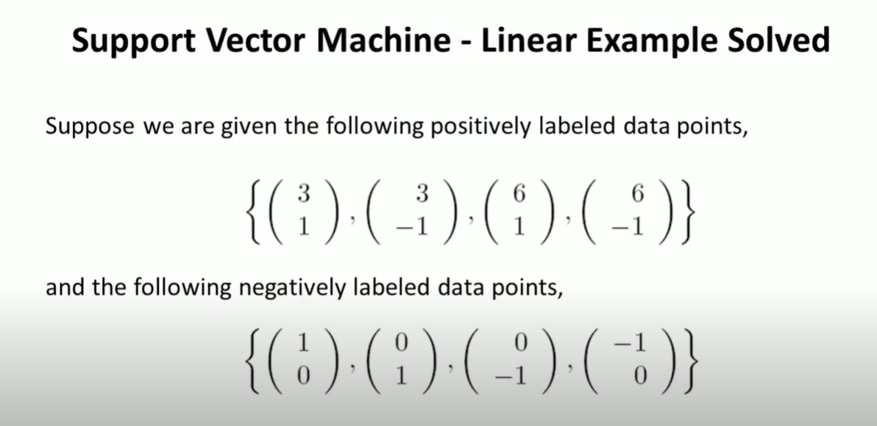
Support Vector Machine | Linear SVM Example

Slide 14
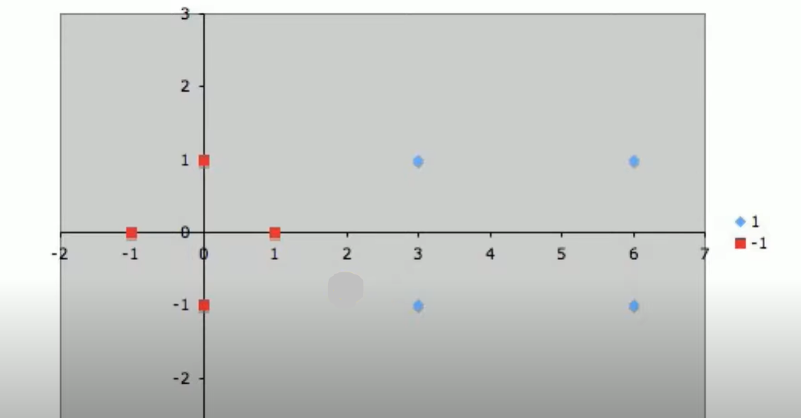

Slide 15
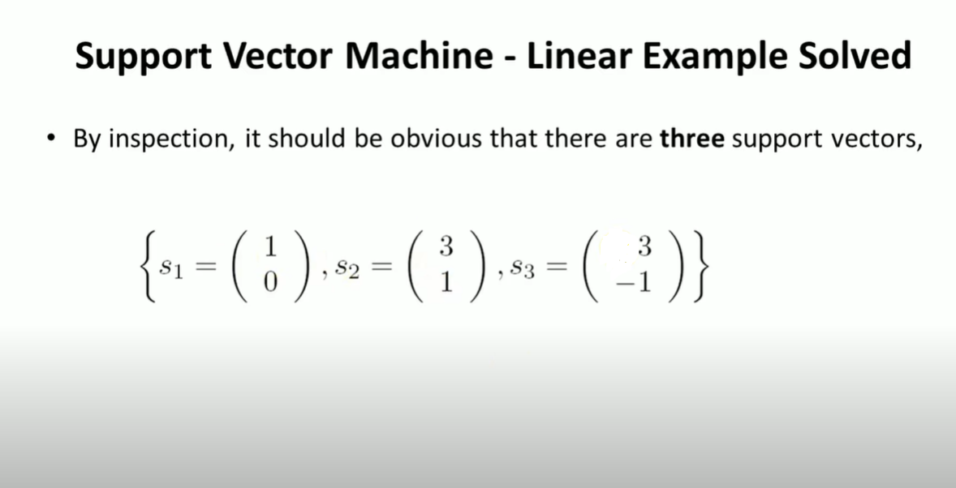

Slide 16
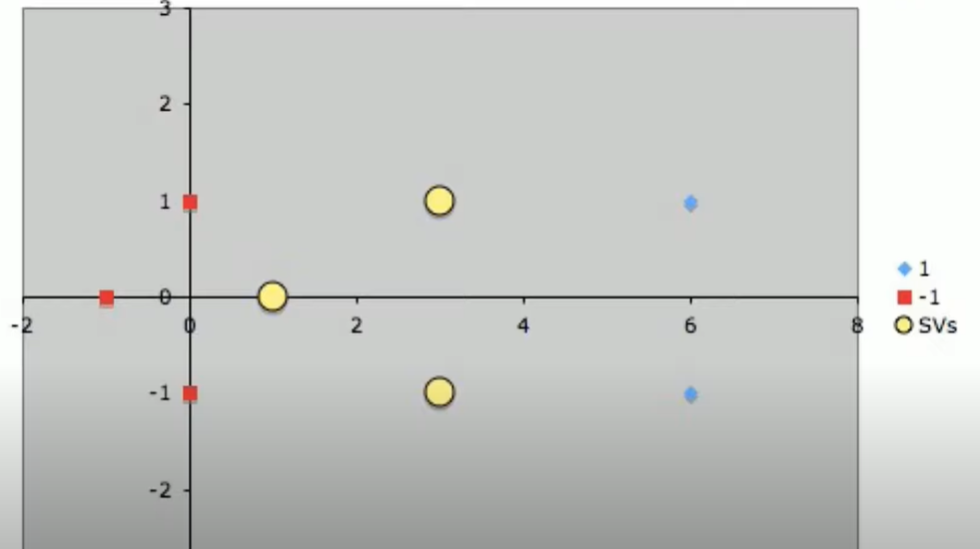

Slide 17
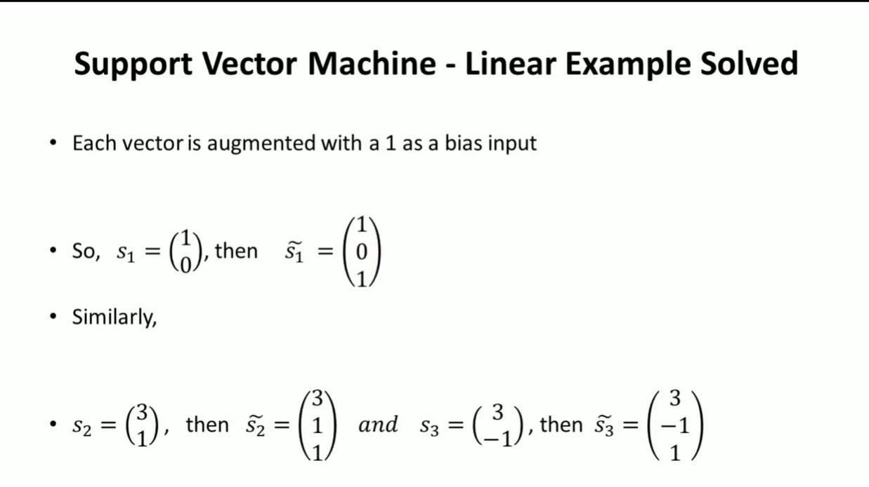

Slide 18
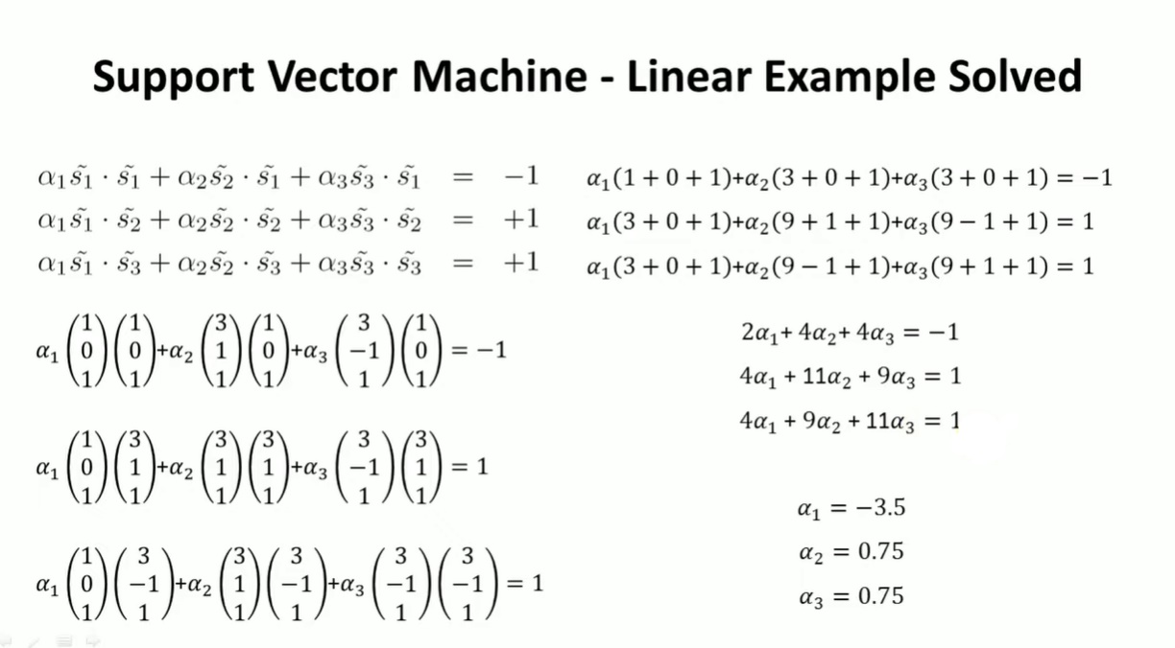

Slide 19
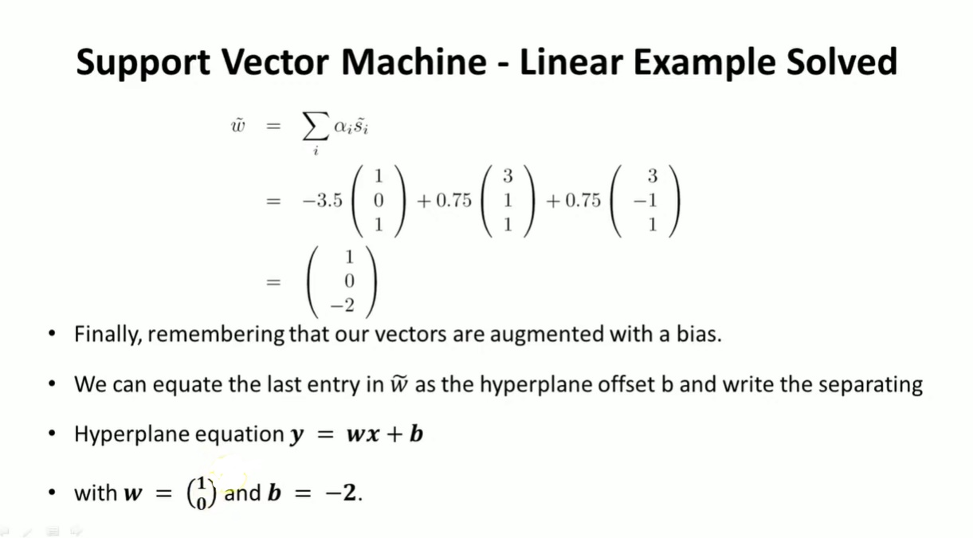

Slide 20
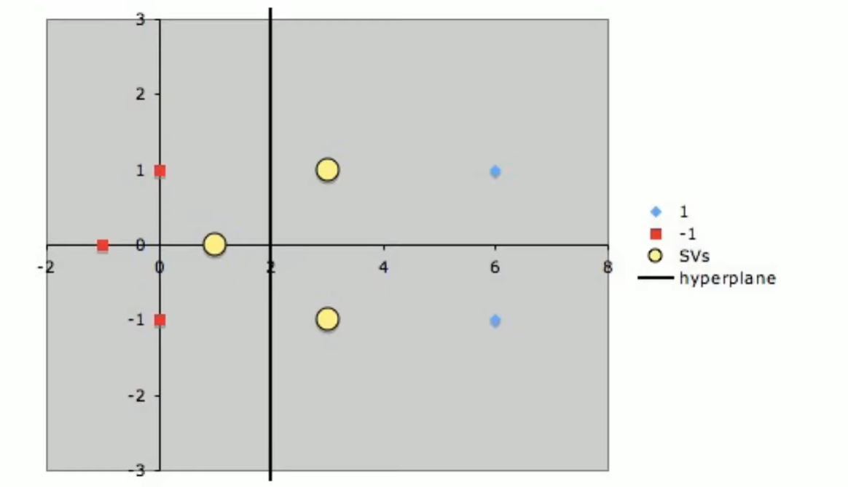

Slide 21
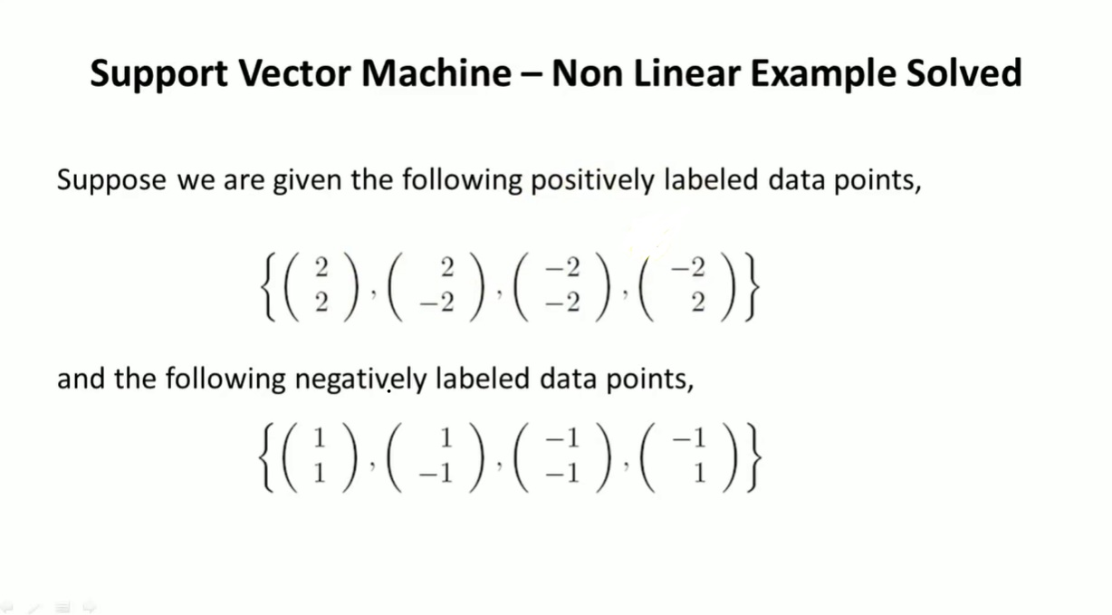
Support Vector Machine | Non-Linear SVM Example

Slide 22
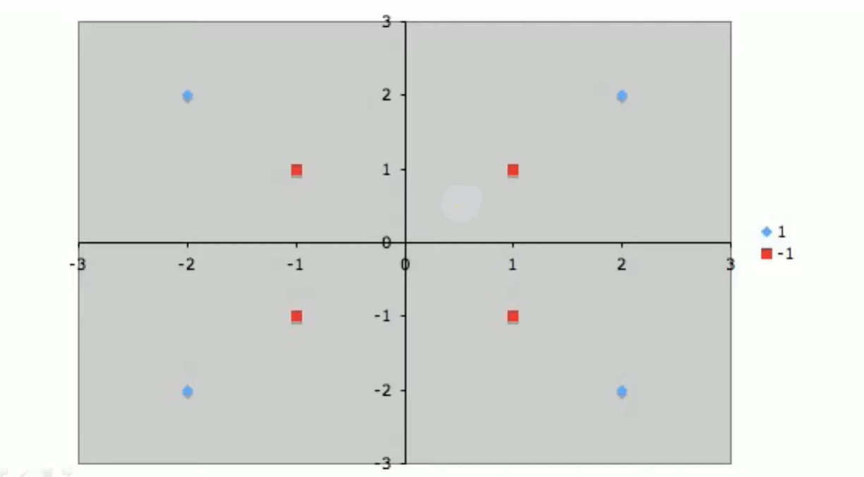

Slide 23
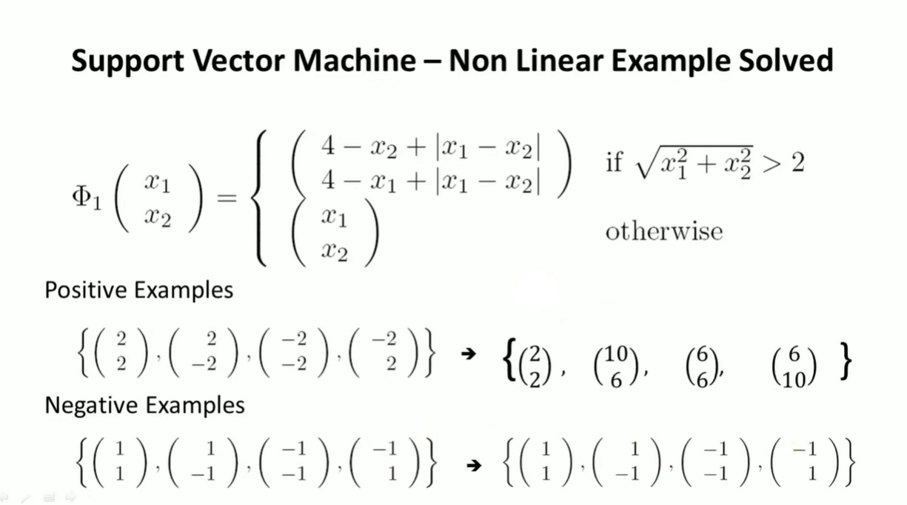

Slide 24
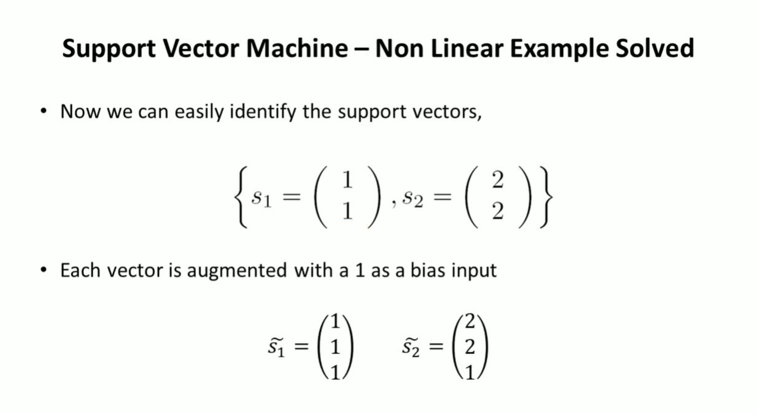

Slide 25
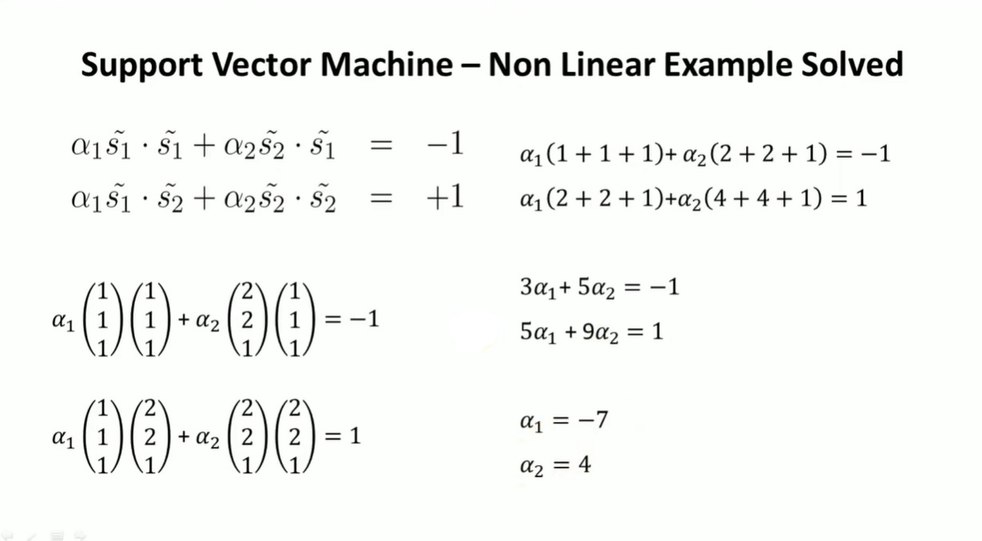

Slide 26
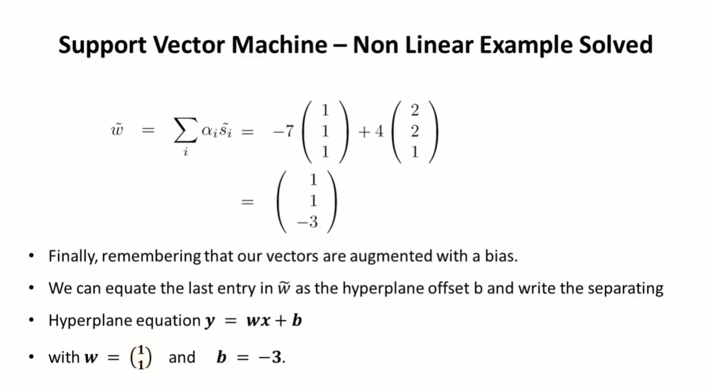

Slide 27
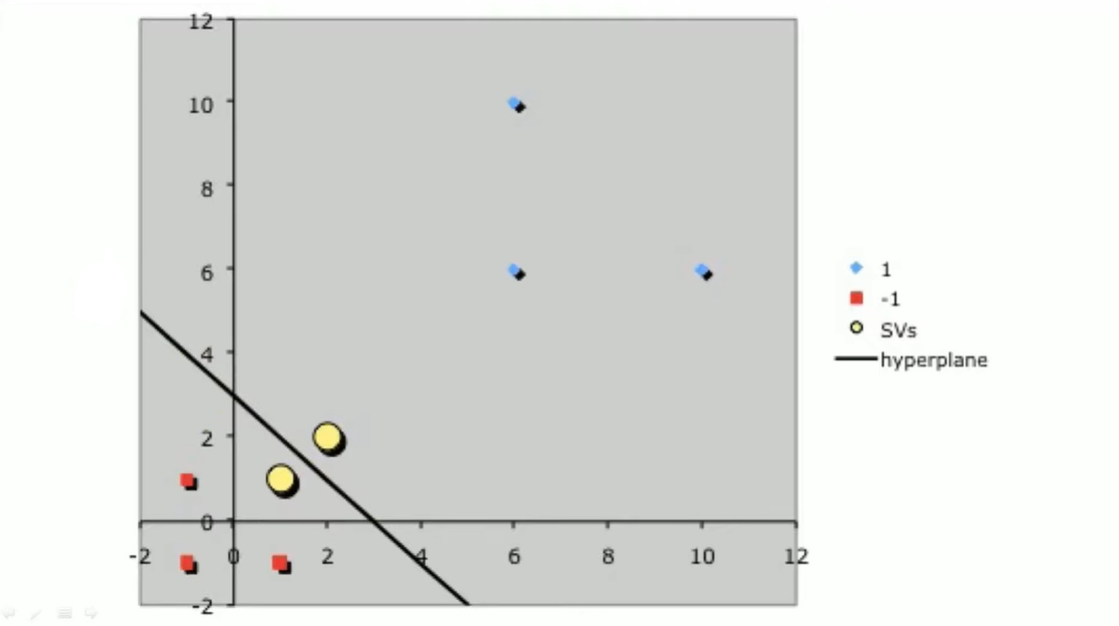

Slide 28
Conclusion
SVM is a supervised learning algorithm which separates the data into different classes through the use of a hyperplane. The chosen hyperplane is one with the greatest margin between the hyperplane and all points, this yields the greatest likelihood of accurate classification. It’s a very versatile, memory efficient algorithm, however it’s prone to overfitting, can be computationally expensive depending on the size of the data and fails to provide a probabilistic explanation of the results.

